Slide 1

E-LEARNING WEB PORTAL
Name- Prasad Malwadkar
Batch- 2B

Slide 2
Software Used:
JAVA
MySQL
Maven
JSP
Tomcat Server
Eclipse
HTML
CSS

Slide 3

Modules
Mainly two modules: Frontend and Backend.
Frontend consists of JSP and Servlet.
Backend is Java and MySQL
Backend integrated into frontend using JAR.
For Integration we have used Maven tool.

Slide 4
Project Overview
Created a e-learning portal with frontend and backend.
There are two types of users mainly Admin and Learner(user).
Admin have the privilege to add the course ,view user info, view feedback given by user etc.
Learners can contact, give feedback and enroll for the course.
The portal is user-friendly.

Slide 5

Frontend
Created the frontend using JSP and servlet and added the JAR file of backend
Created forms using JSP and Servlet for the functionalities.
In the frontend the learner and admin can Sign up and login.
Admin can view the list of learners and add the course details .
Added Ul using basic HTML and CSS.

Slide 6
Backend
Made a Java project and connected it with MySQL DB.
Created tables using MySQL according to the requirement.
Added functionalities like user registration, add new course, contact , feedback, etc.
Exported the project as JAR file using maven install.

Slide 7
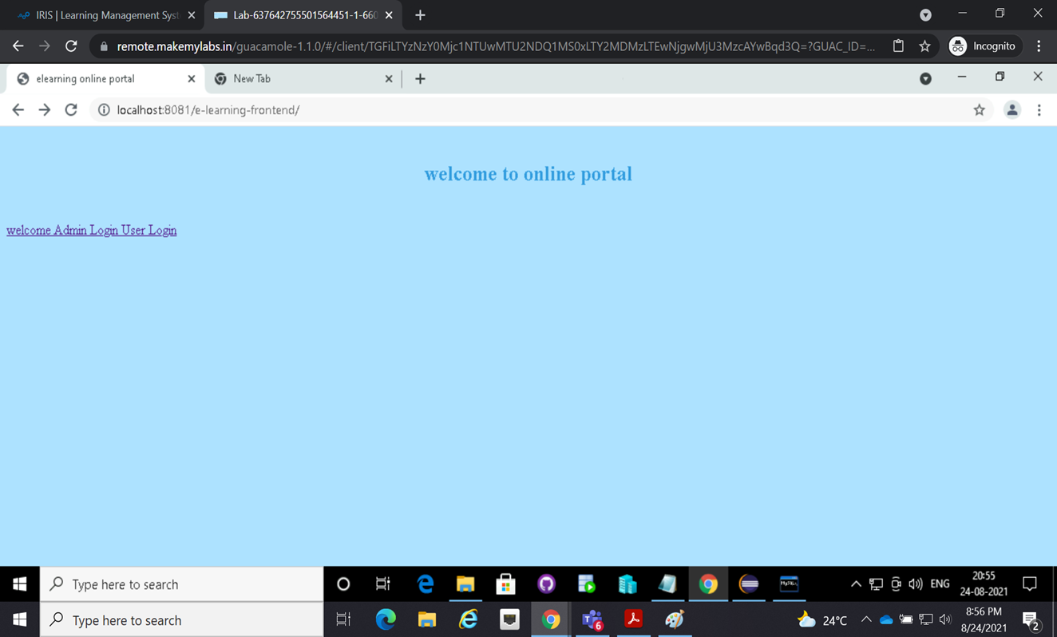
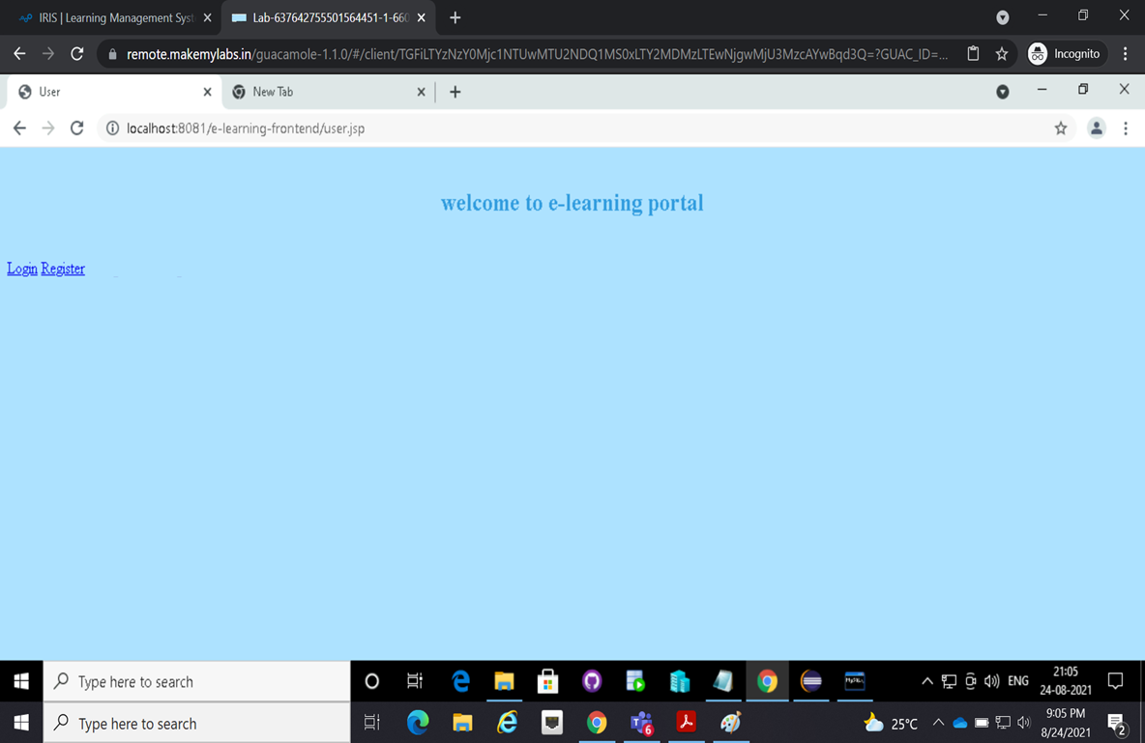
Welcome Page

Slide 8
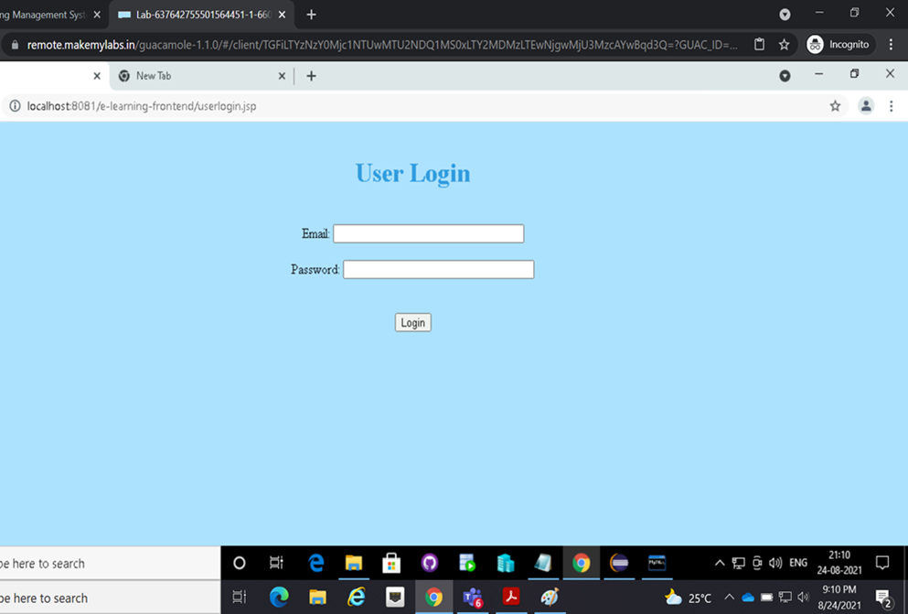
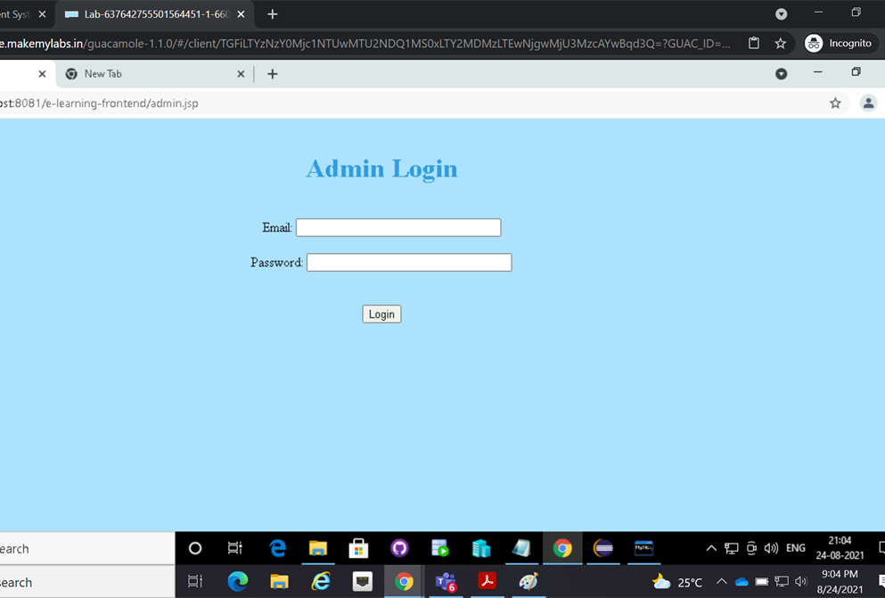
Login Page

Slide 9
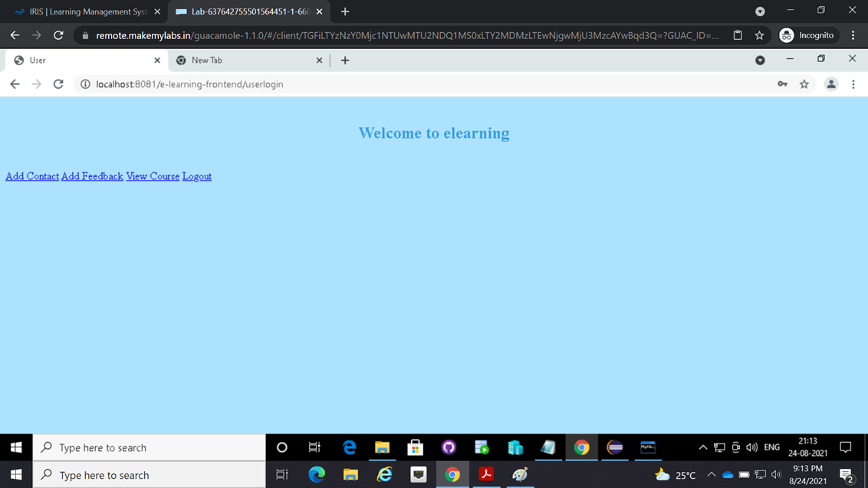
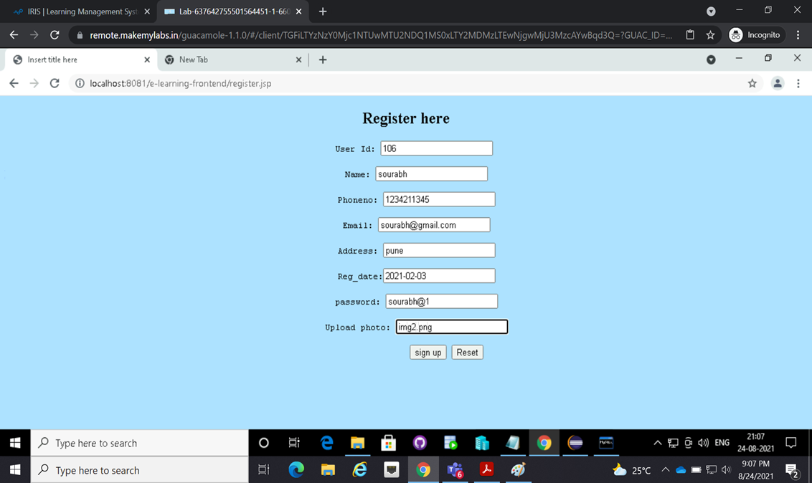
Welcome view and User registration

Slide 10
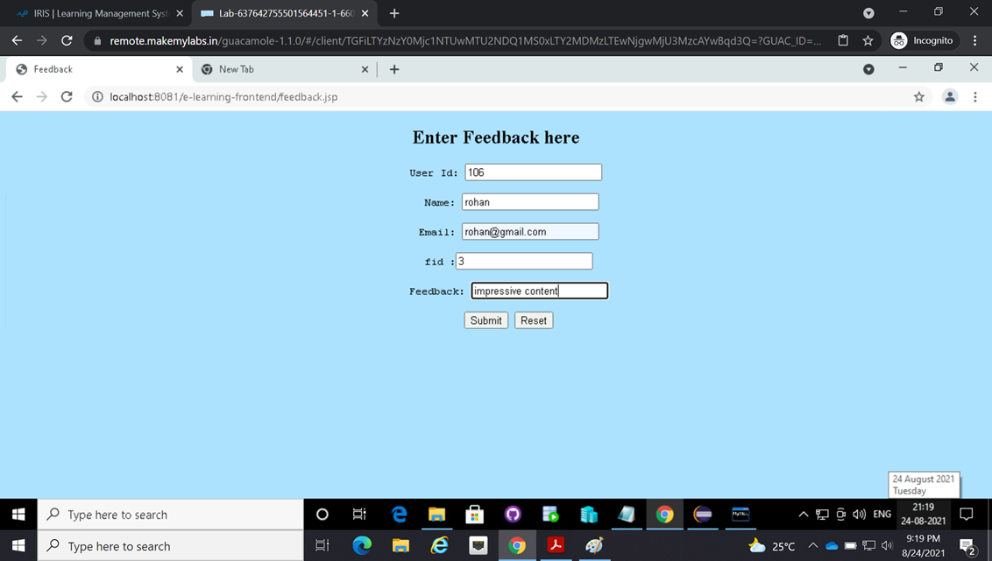
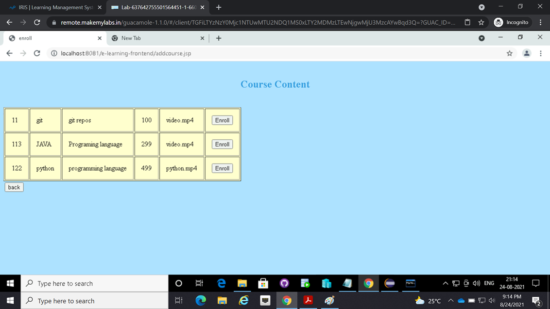
User Feedback And course list

Slide 11
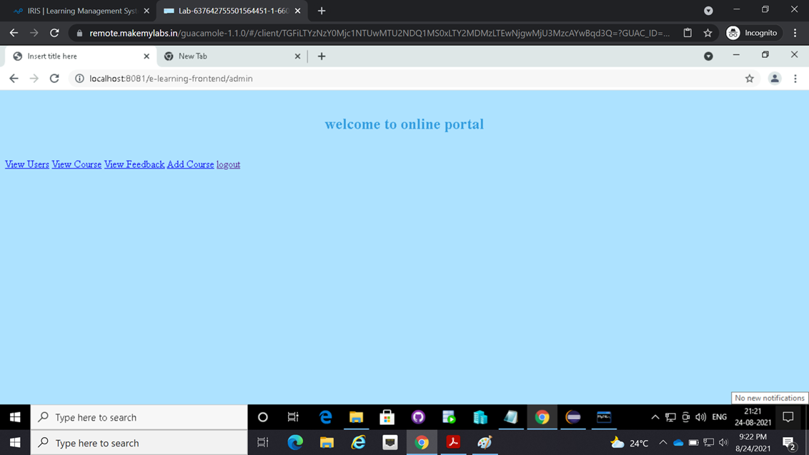
Admin Login View

Slide 12
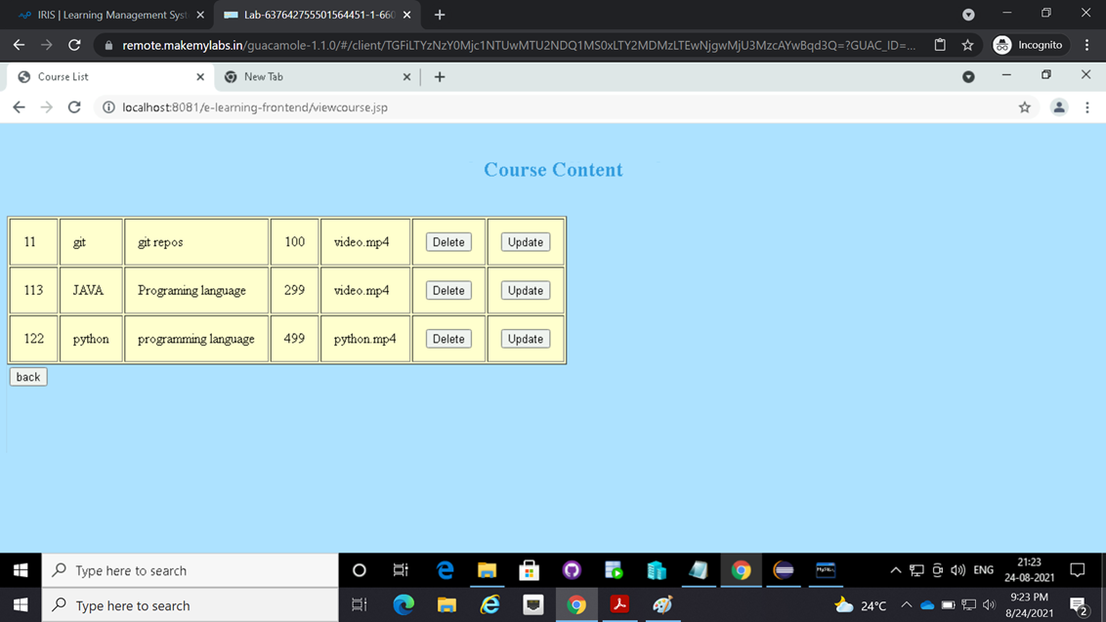
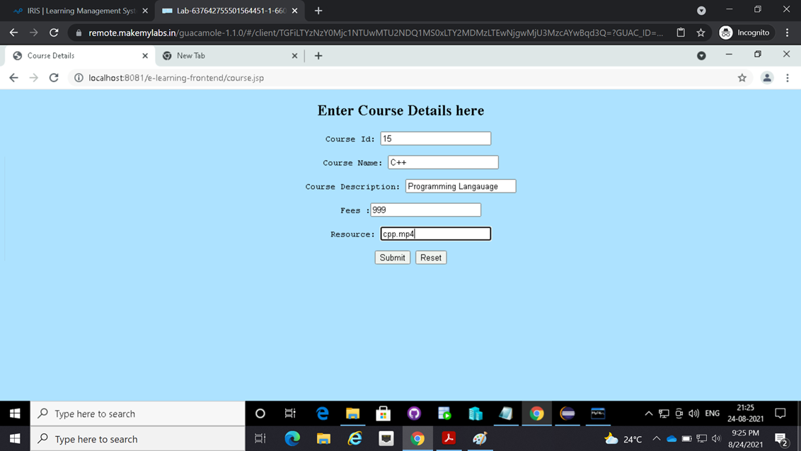
Admin course list and add new course

Slide 13
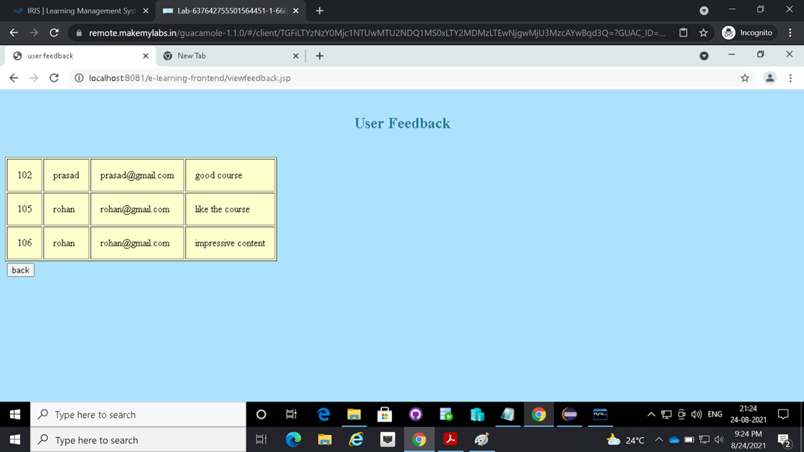
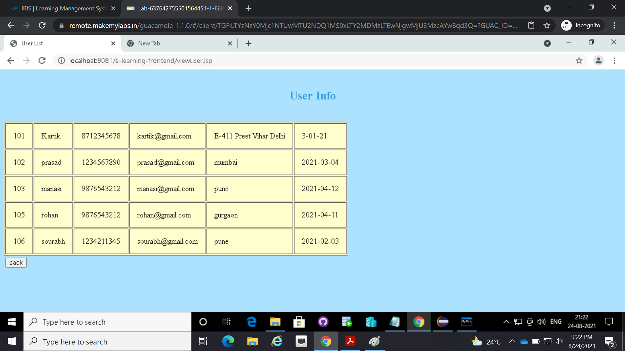
Admin User feedback list and User list

Slide 14
THANK YOU ☺

